Slide 1


CLOSED-LOOP SVPWM
BLDC MOTOR CONTROLLER
SVPWM GENERATION | Embedded Systems | Automation |
1

Slide 2

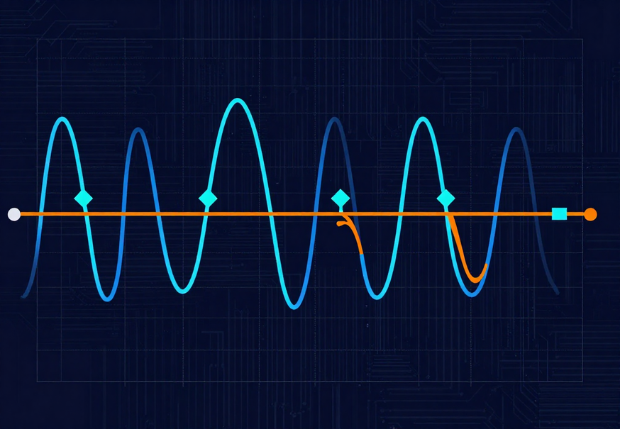
SVPWM BLDC Controller
STARTUP STRATEGY
Open-loop forced commutation at startup transitions to closed-loop sensorless control once sufficient back-EMF is established.
BACK-EMF DETECTION
OBSERVER-BASED
NOISE FILTERING
Zero-crossing detection
Phase voltage sensing
Sliding mode observer
Real-time estimation
Low-pass filter stage
Debounce & hysteresis
SENSORLESS ROTOR ESTIMATION
No Hall Sensors Required
Rotor position and velocity are inferred in real time from back-EMF signals, eliminating physical sensors and reducing system complexity.
2

Slide 3
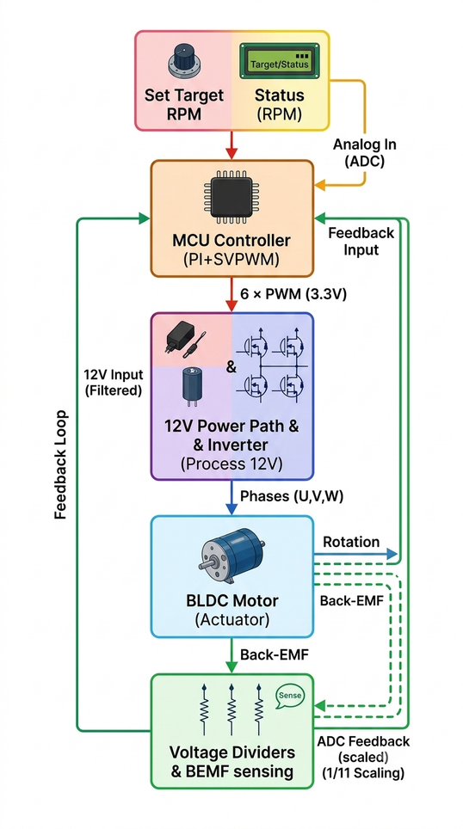
CLOSED-LOOP
SENSORLESS BLDC
MOTOR CONTROL
SVPWM-Based Inverter Control System
DESIGN OBJECTIVE
  Develop a sensorless BLDC motor controller.
  Generate 3-phase excitation using a discrete MOSFET inverter.
  Implement SVPWM for efficient motor control.
  Detect rotor position using Back-EMF zero-crossing.
  Maintain target RPM using a PI speed controller.
  Validate the design using a MATLAB/Simulink digital twin.
3

Slide 4
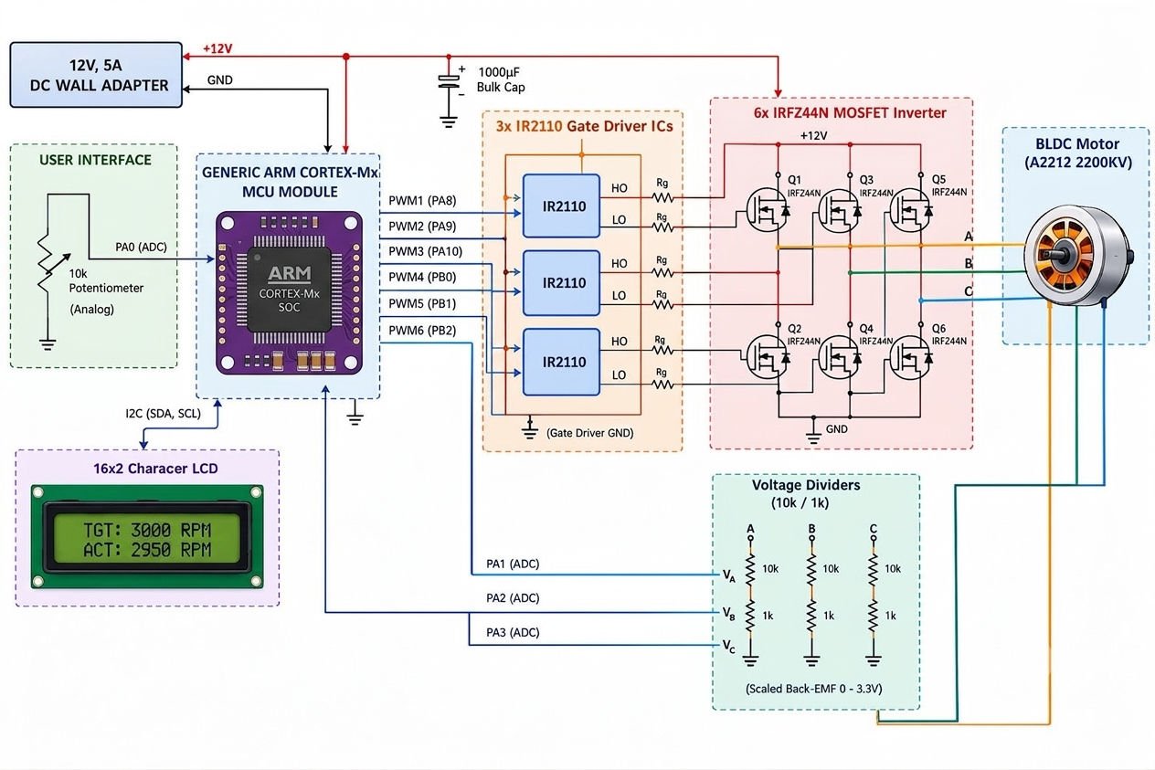
SYSTEM ARCHITECTURE
Control System Structure
The closed-loop architecture integrates a sensorless back-EMF observer with cascaded speed and current controllers, driving the three-phase inverter via Space Vector PWM modulation.
4

Slide 5
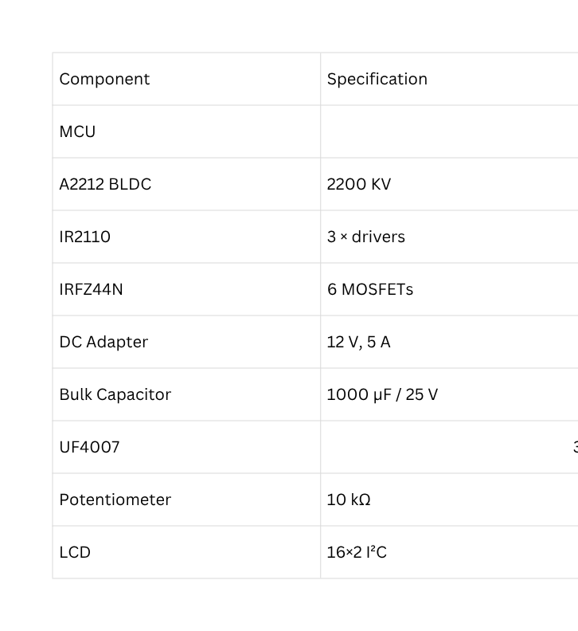
Hardware Components
5

Slide 6
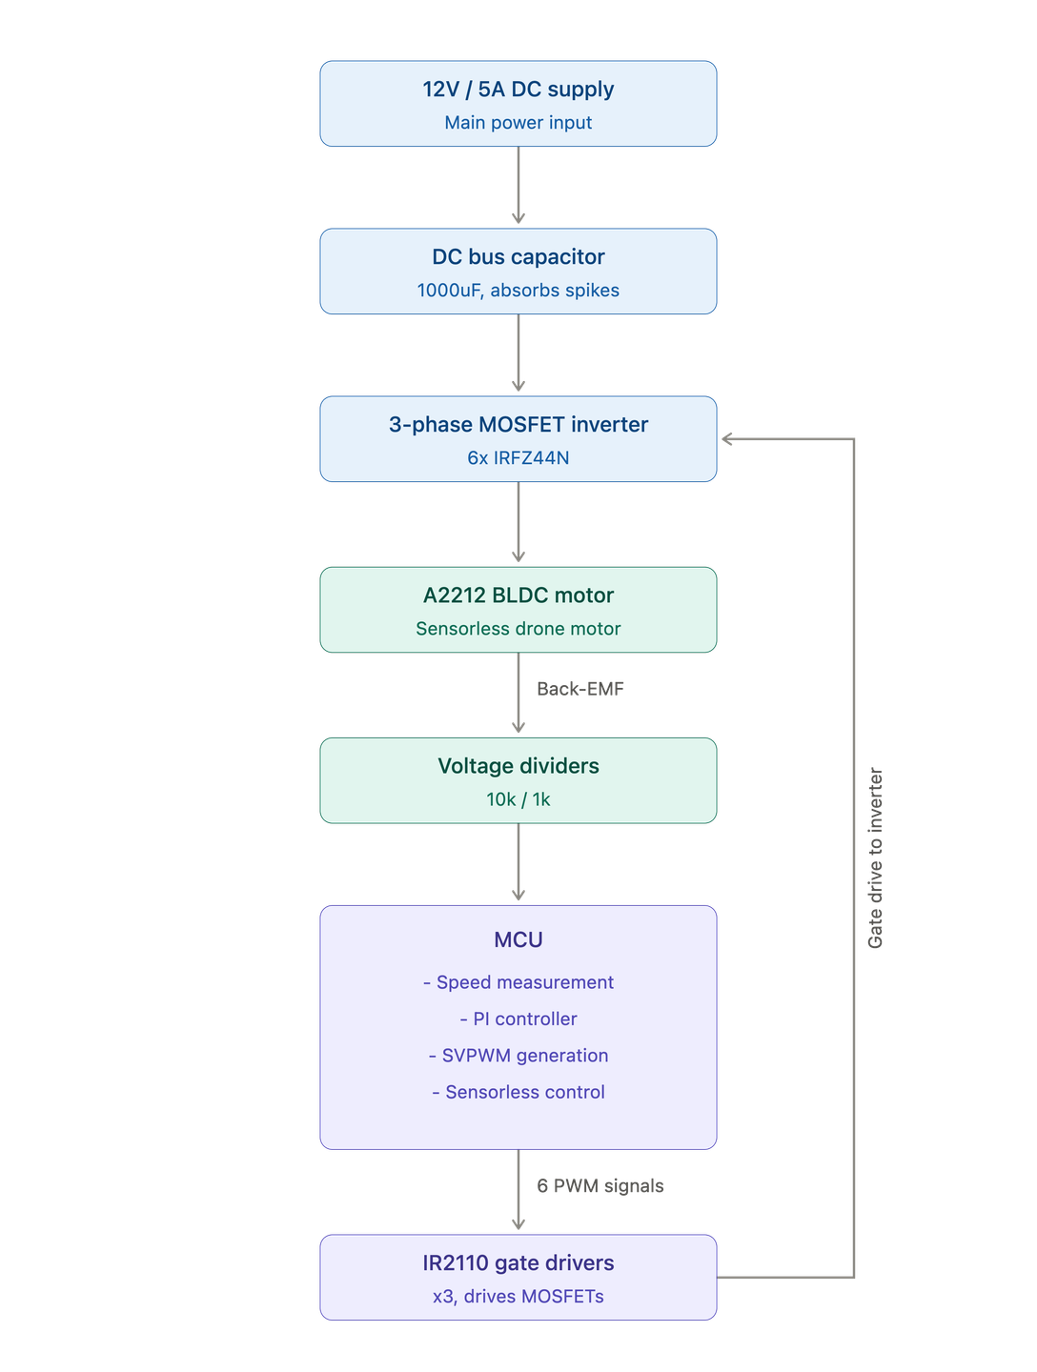
SYSTEM WORKING PRINCIPLE
  12 V DC supply powers the DC bus and 3-phase inverter.
  10 kΩ potentiometer sets the desired motor speed.
  MCU reads the speed command and motor feedback.
  PI controller compares target RPM with actual RPM and generates the control command.
  SVPWM converts the control command into six PWM gate signals.
  IR2110 drivers amplify the PWM signals for MOSFET gate driving.
  Six IRFZ44N MOSFETs form the 3-phase inverter and drive the A2212 BLDC motor.
  The rotating motor generates Back-EMF on the floating phase.
  Voltage dividers scale the Back-EMF signals for safe MCU ADC measurement.
  The MCU detects Back-EMF zero-crossings to estimate rotor position without Hall sensors.
  The feedback is used by the PI controller to maintain the desired RPM.
  16×2 LCD displays the target and actual motor speed.
  Control Flow:
Target RPM → MCU (PI + SVPWM) → IR2110 → MOSFET Inverter → BLDC Motor → Back-EMF → MCU Feedback
6

Slide 7
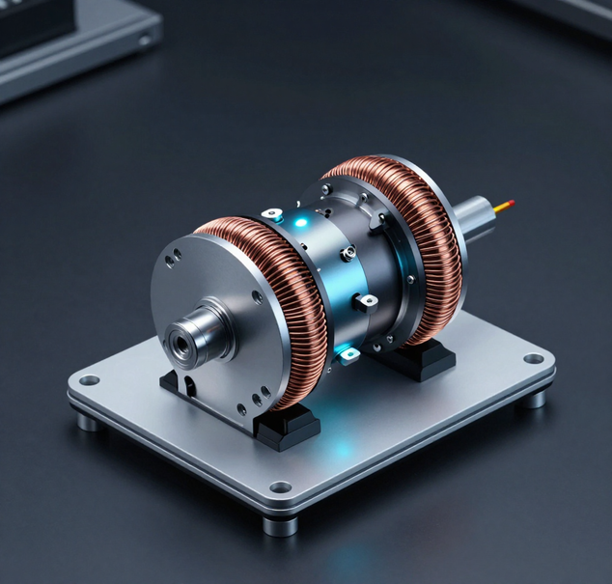
VALIDATION
RESULTS & REVIEW
Closed-loop SVPWM BLDC controller demonstrates robust sensorless performance across all tested operating conditions and speed ranges.
KEY TAKEAWAYS
Speed tracking accuracy within ±1.5% across full operating range via closed-loop PI control.
Phase current THD below 4.2%, confirming high-quality SVPWM modulation output.
Transient step response settles within 18ms with no overshoot beyond 6% of setpoint.
Efficiency of 94.3% achieved at rated load with stable thermal performance.
Sensorless back-EMF estimation maintains rotor lock above 8% of rated speed.
REQUEST TECHNICAL EVALUATION
Conclusion
+123-456-7890
@engineering.review
www.reallygreatsite.com
Cloudlet Tech
7

Slide 8
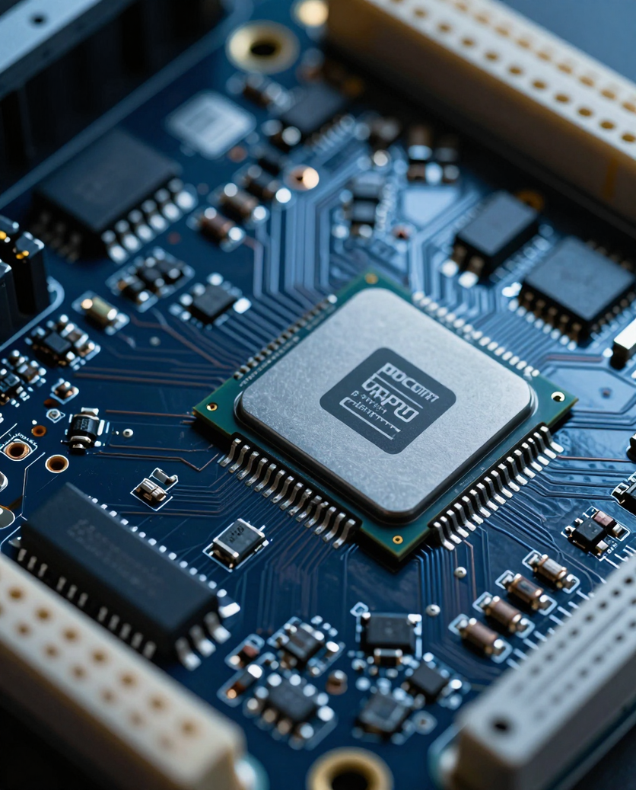
FIRMWARE
EXECUTION
ARCHITECTURE
Embedded Real-Time Control
The control firmware executes in a deterministic interrupt-driven loop, synchronized to the PWM carrier period, ensuring precise timing for ADC sampling, transform computation, and register updates.
ISR TIMING & ADC ACQUISITION
PWM period-synchronized ISR trigger
Center-aligned ADC sampling at PWM trough
Dual-channel simultaneous phase current capture
PI CONTROLLERS & PWM UPDATE
Independent d-axis and q-axis PI loops with anti-windup; Vd, Vq → SVPWM duty registers updated each cycle.
CLARKE / PARK TRANSFORMS
Ia, Ib → Iα, Iβ via Clarke transform
Iα, Iβ → Id, Iq via Park (rotor angle θ)
Fixed-point Q15 arithmetic for speed
CloudletTech
8

Slide 9
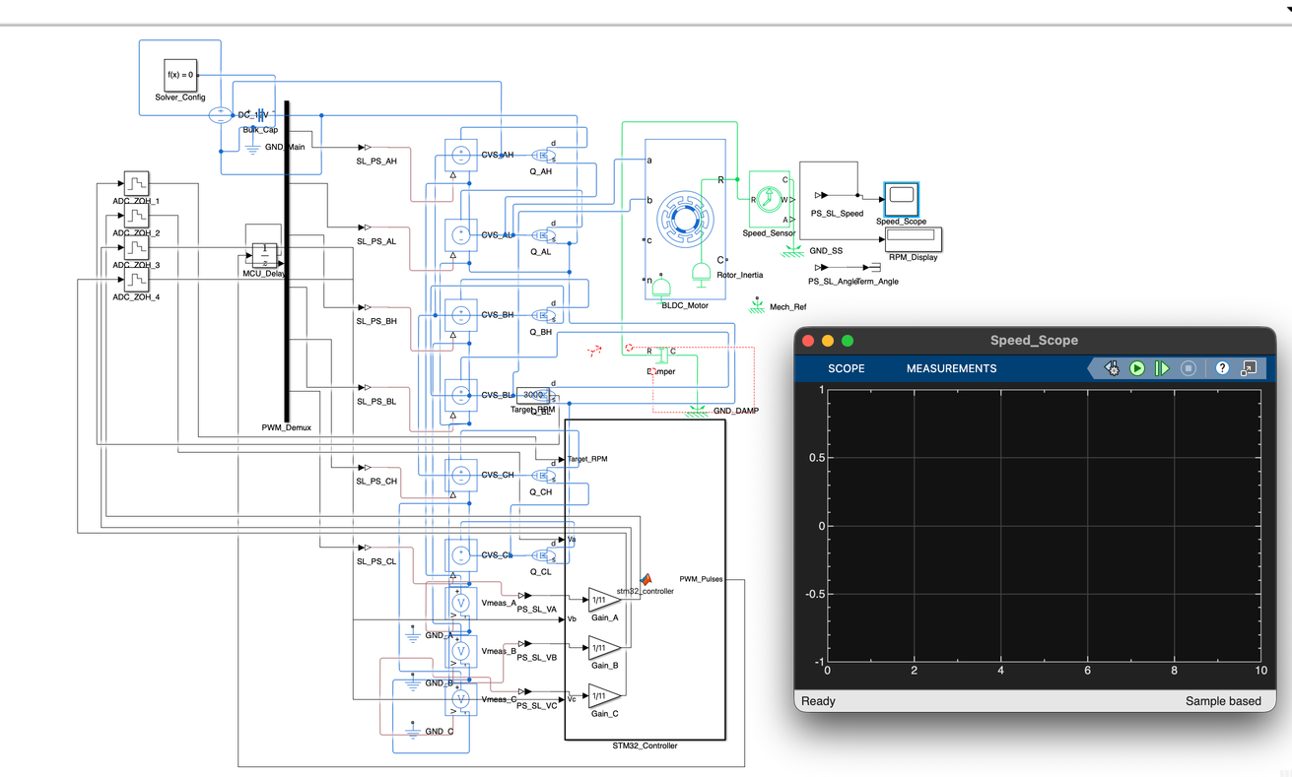
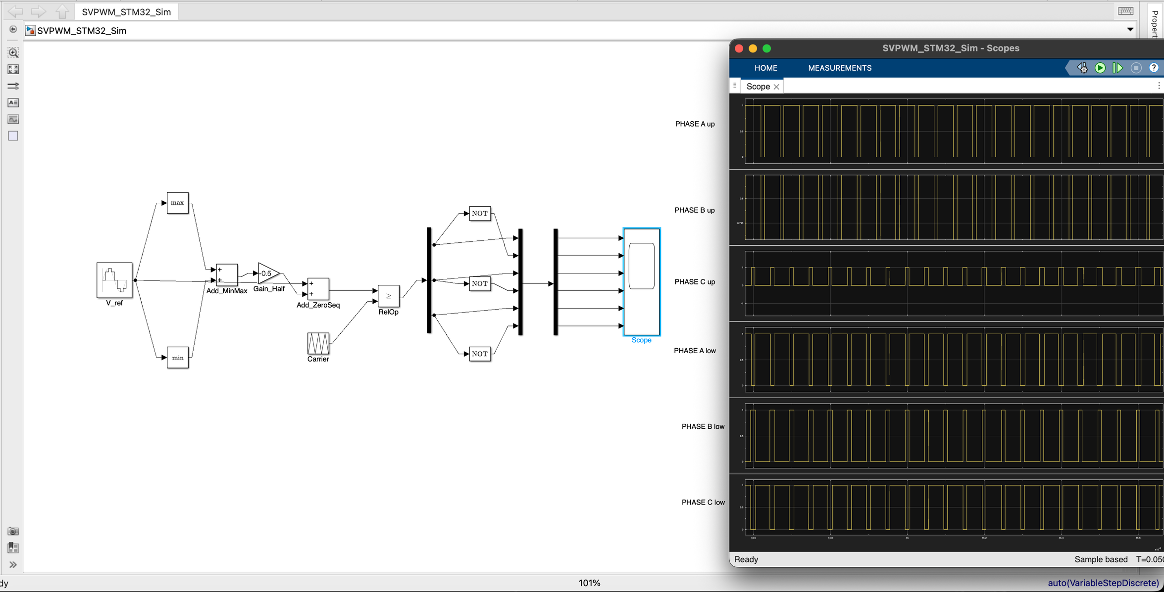
SIMULATION &VERIFICATION
MATLAB/SIMULINK MODEL
Closed-loop SVPWM model
Sensorless observer simulation
SVPWM SIGNAL VERIFICATION
PWM switching patterns
Dead-time compensation
Stage 1 - Simulink closed-loop model verified
Stage 2 - Gate drive signals confirmed on scope
Stage 3 - Sensorless startup achieved at no-load
Stage 4 - Speed & load step response validated
9

Slide 10
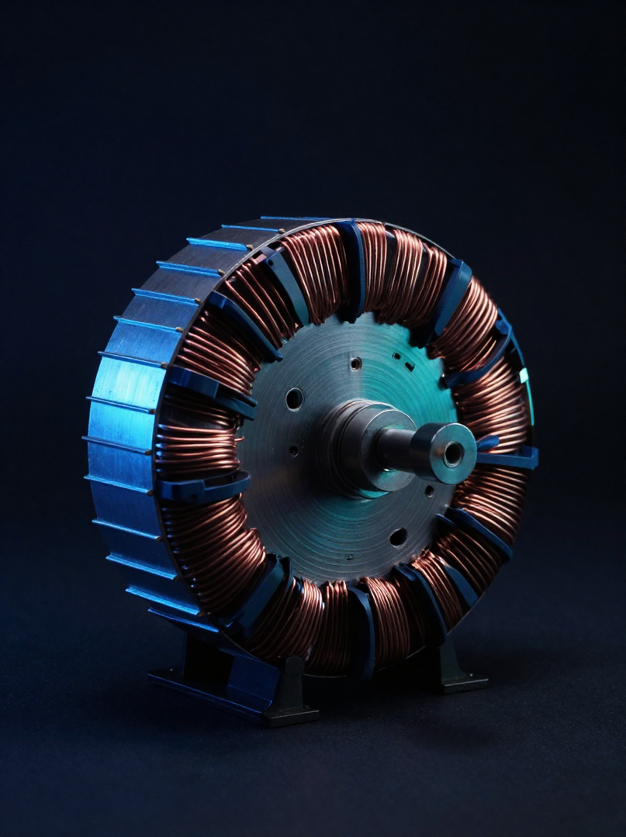
Closed-loop sensorless control delivers precision, efficiency, and robustness without mechanical sensing hardware.
Development Milestones
Phase 1 - Power stage design and inverter layout
Phase 2 - Back-EMF observer implementation
Phase 3 - Closed-loop PI controller tuning
Phase 4 - SVPWM validation and system integration
SENSORLESS OPERATION
HIGH EFFICIENCY
INDUSTRIAL SCALABILITY
No Hall sensors required
Back-EMF estimation
Reduced BOM cost
SVPWM minimizes THD
Optimal voltage utilization
Fault-aware protection
Adaptable to load profiles
Why Sensorless SVPWM BLDC Control
CORE DESIGN
BENEFITS
Dynamic speed regulation
Reduced hardware complexity
Fault-aware operation
Closed-loop precision
KEY TECHNICAL
ADVANTAGES
Cloudlet Tech
10

Slide 11
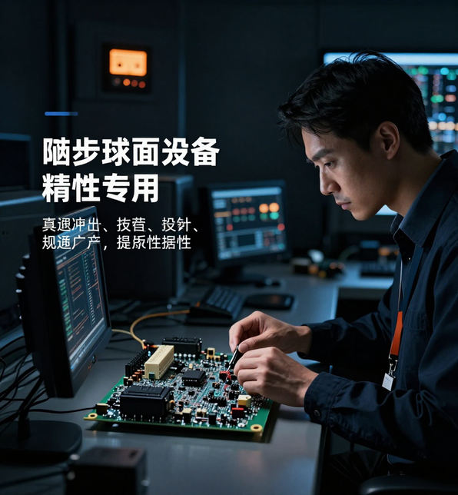
SVPWM BLDC Control
PROBLEM DEFINITION
& OBJECTIVES
Hall-effect sensors introduce mechanical fragility, thermal drift, and added cost in BLDC motor systems — demanding a robust sensorless alternative.
SENSOR LIMITATIONS
KEY PROBLEM
Thermal sensitivity
Mechanical misalignment
Added BOM cost
Hall sensors fail at high temperatures and vibration, reducing system reliability in industrial environments.
CONTROL OBJECTIVES
Closed-loop speed regulation
Back-EMF position estimation
Engineering Motivation & Goals
SVPWM GOALS
Reduced torque ripple
Improved DC bus utilization
SYSTEM TARGETS
±2% steady-state speed accuracy
Embedded MCU implementation
11

Slide 12
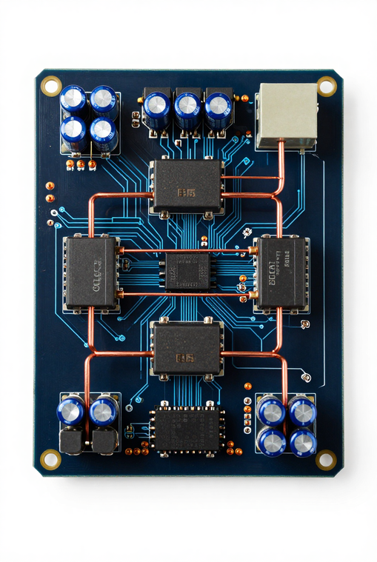
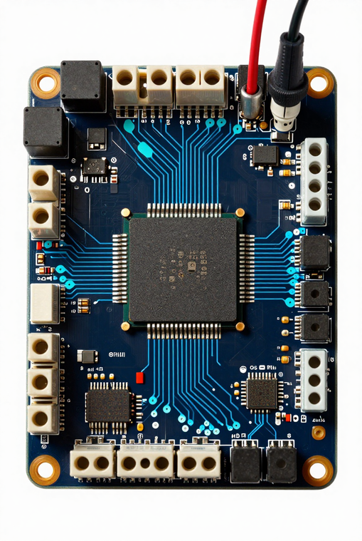
POWER STAGE
IMPLEMENTATION
Three-Phase Inverter & Embedded Execution
The power stage integrates a three-phase MOSFET bridge with isolated gate drivers, DC-link capacitance, and real-time microcontroller execution for precise SVPWM switching.
INVERTER & GATE DRIVER
MCU & PROTECTION
Six N-channel MOSFETs | Bootstrap gate drivers | Dead-time insertion | DC-link bulk capacitor
PWM timer peripherals | Overcurrent shutdown | Under-voltage lockout | Thermal monitoring
Switching frequency of 20 kHz with hardware fault latching ensures safe and efficient motor drive operation.
Cloudlet Tech
12

Slide 13
REFERENCES
REFERENCES
  STMicroelectronics — STM32F446RE Datasheet
  https://www.st.com/resource/en/datasheet/stm32f446re.pdf
  Infineon — IR2110 Gate Driver Datasheet
  https://www.infineon.com/part/IR2110
  Infineon — IRFZ44N MOSFET Datasheet
  https://www.infineon.com/part/IRFZ44N
  MathWorks — Simscape Electrical Documentation
  https://www.mathworks.com/help/simscape-electrical/
  MathWorks — Space Vector PWM
  https://www.mathworks.com/help/mcb/gs/space-vector-pwm.html
13

Slide 14
PROJECT
CONCLUSION
A compact, fully integrated sensorless SVPWM BLDC controller — bridging estimation theory with real-time embedded motor control.
14

